Slide 1
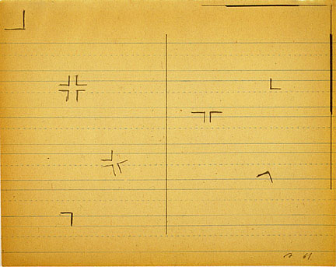
BLAST and FASTA

Slide 2
Pairwise Alignment
Global
Local
Best score from among alignments of full-length sequences
Needelman-Wunch algorithm
Best score from among alignments of partial sequences
Smith-Waterman algorithm

Slide 3
Why do we need local alignments?
To compare a short sequence to a large one.
To compare a single sequence to an entire database
To compare a partial sequence to the whole.

Slide 4
Why do we need local alignments?
Identify newly determined sequences
Compare new genes to known ones
Guess functions for entire genomes full of ORFs of unknown function

Slide 5

Mathematical Basis for Local Alignment
Model matches as a sequence of coin tosses
Let p be the probability of “head”
  For a “fair” coin, p = 0.5
According to Paul Erdös-Alfréd Rényi law:
If there are n throws, then the expected length, R, of the longest run of “heads” is
R = log_{1/p} (n).
Paul Erdös
“Another roof, another proof”

Slide 6
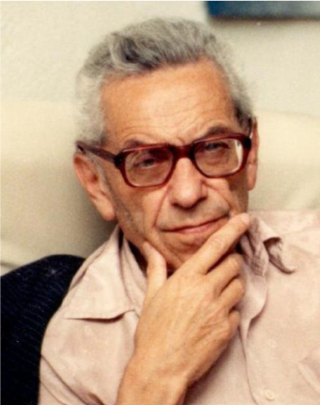

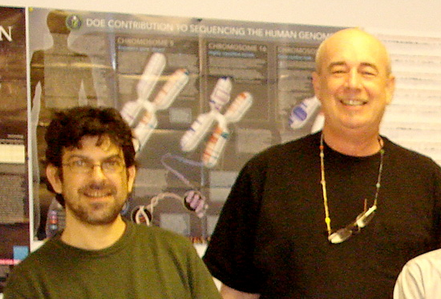
3
0
1
2
Erdös Number

Slide 7
Mathematical Basis for Local Alignment
Example: Suppose n = 20 for a “fair” coin
R=log₂(20)=4.32
Problem: How does one model DNA (or amino acid) alignments as coin tosses.

Slide 8
Modeling Sequence Alignments
To model random sequence alignments, replace a match by “head” (H) and mismatch by “tail” (T).
For ungapped DNA alignments, the probability of a “head” is 1/4.
For ungapped amino acid alignments, the probability of a “head” is 1/20.
AATCAT
ATTCAG
HTHHHT

Slide 9
Modeling Sequence Alignments
Thus, for any one particular alignment, the Erdös-Rényi law can be applied
What about for all possible alignments?
  Consider that sequences can being shifted back and forth in the dot matrix plot
The expected length of the longest match is
R = log_{1/p}(mn)
where m and n are the lengths of the two sequences.

Slide 10
Modeling Sequence Alignments
Suppose m = n = 10, and we deal with DNA sequences
R = log₄(100) = 3.32
This analysis assumes that the base composition is uniform and the alignment is ungapped. The result is approximate, but not bad.

Slide 11
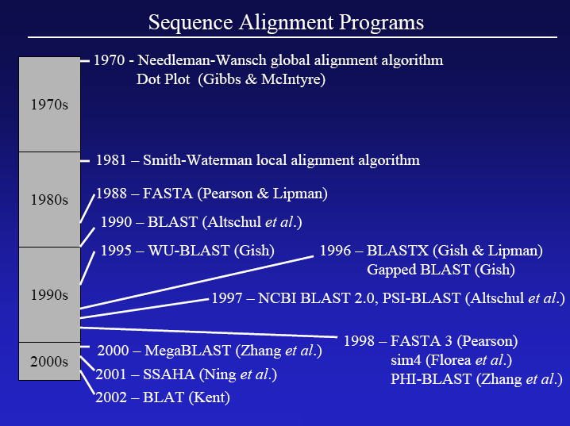

Slide 12
Heuristic Methods: FASTA and BLAST
FASTA
First fast sequence searching algorithm for comparing a query sequence against a database.
BLAST
Basic Local Alignment Search Technique
improvement of FASTA: Search speed, ease of use, statistical rigor.

Slide 13
FASTA and BLAST
Basic idea: a good alignment contains subsequences of absolute identity (short lengths of exact matches):
  First, identify very short exact matches.
  Next, the best short hits from the first step are extended to longer regions of similarity.
  Finally, the best hits are optimized.

Slide 14
FASTA
Derived from logic of the dot plot
  compute best diagonals from all frames of alignment
The method looks for exact matches between words in query and test sequence
  DNA words are usually 6 nucleotides long
  protein words are 2 amino acids long

Slide 15
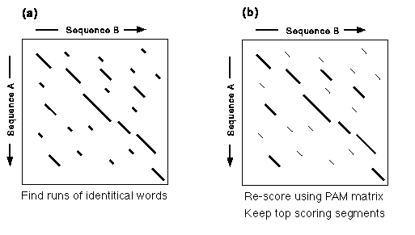
FASTA Algorithm

Slide 16
Makes Longest Diagonal
After all diagonals are found, tries to join diagonals by adding gaps
Computes alignments in regions of best diagonals

Slide 17
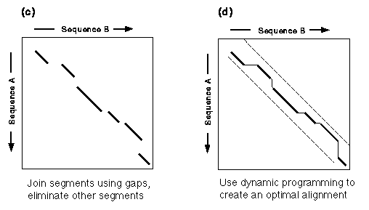
FASTA Alignments

Slide 18
FASTA Results - Histogram
!!SEQUENCE_LIST 1.0
(Nucleotide) FASTA of: b2.seq from: 1 to: 693 December 9, 2002 14:02
TO: /u/browns02/Victor/Search-set/*.seq Sequences: 2,050 Symbols:
913,285 Word Size: 6
Searching with both strands of the query.
Scoring matrix: GenRunData:fastadna.cmp
Constant pamfactor used
Gap creation penalty: 16 Gap extension penalty: 4
Histogram Key:
Each histogram symbol represents 4 search set sequences
Each inset symbol represents 1 search set sequences
z-scores computed from opt scores
z-score obs exp
(=) (*)
< 20 0 0:
22 0 0:
24 3 0:=
26 2 0:=
28 5 0:==
30 11 3:*==
32 19 11:==*==
34 38 30:=======*==
36 58 61:===============*
38 79 100:==================== *
40 134 140:==================================*
42 167 171:==========================================*
44 205 189:===============================================*====
46 209 192:===============================================*=====
48 177 184:=============================================*

Slide 19
FASTA Results - List
The best scores are: init1 initn opt z-sc E(1018780)..
SW:PPI1_HUMAN Begin: 1 End: 269
! Q00169 homo sapiens (human). phosph... 1854 1854 1854 2249.3 1.8e-117
SW:PPI1_RABIT Begin: 1 End: 269
! P48738 oryctolagus cuniculus (rabbi... 1840 1840 1840 2232.4 1.6e-116
SW:PPI1_RAT Begin: 1 End: 270
! P16446 rattus norvegicus (rat). pho... 1543 1543 1837 2228.7 2.5e-116
SW:PPI1_MOUSE Begin: 1 End: 270
! P53810 mus musculus (mouse). phosph... 1542 1542 1836 2227.5 2.9e-116
SW:PPI2_HUMAN Begin: 1 End: 270
! P48739 homo sapiens (human). phosph... 1533 1533 1533 1861.0 7.7e-96
SPTREMBL_NEW:BAC25830 Begin: 1 End: 270
! Bac25830 mus musculus (mouse). 10, ... 1488 1488 1522 1847.6 4.2e-95
SP_TREMBL:Q8N5W1 Begin: 1 End: 268
! Q8n5w1 homo sapiens (human). simila... 1477 1477 1522 1847.6 4.3e-95
SW:PPI2_RAT Begin: 1 End: 269
! P53812 rattus norvegicus (rat). pho... 1482 1482 1516 1840.4 1.1e-94

Slide 20
FASTA Results - Alignment
SCORES Init1: 1515 Initn: 1565 Opt: 1687 z-score: 1158.1 E(): 2.3e-58
>>GB_IN3:DMU09374 (2038 nt)
initn: 1565 init1: 1515 opt: 1687 Z-score: 1158.1 expect(): 2.3e-58
66.2% identity in 875 nt overlap
(83-957:151-1022)
60 70 80 90 100 110
u39412.gb_pr CCCTTTGTGGCCGCCATGGACAATTCCGGGAAGGAAGCGGAGGCGATGGCGCTGTTGGCC
|| ||| | ||||| | ||| |||||
DMU09374 AGGCGGACATAAATCCTCGACATGGGTGACAACGAACAGAAGGCGCTCCAACTGATGGCC
130 140 150 160 170 180
120 130 140 150 160 170
u39412.gb_pr GAGGCGGAGCGCAAAGTGAAGAACTCGCAGTCCTTCTTCTCTGGCCTCTTTGGAGGCTCA
||||||||| || ||| | | || ||| | || || ||||| ||
DMU09374 GAGGCGGAGAAGAAGTTGACCCAGCAGAAGGGCTTTCTGGGATCGCTGTTCGGAGGGTCC
190 200 210 220 230 240
180 190 200 210 220 230
u39412.gb_pr TCCAAAATAGAGGAAGCATGCGAAATCTACGCCAGAGCAGCAAACATGTTCAAAATGGCC
||| | ||||| || ||| |||| | || | |||||||| || ||| ||
DMU09374 AACAAGGTGGAGGACGCCATCGAGTGCTACCAGCGGGCGGGCAACATGTTTAAGATGTCC
250 260 270 280 290 300
240 250 260 270 280 290
u39412.gb_pr AAAAACTGGAGTGCTGCTGGAAACGCGTTCTGCCAGGCTGCACAGCTGCACCTGCAGCTC
|||||||||| ||||| | |||||| |||| ||| || ||| || |
DMU09374 AAAAACTGGACAAAGGCTGGGGAGTGCTTCTGCGAGGCGGCAACTCTACACGCGCGGGCT
310 320 330 340 350 360

Slide 21

FASTA on the Web
Many websites offer FASTA searches
Each server has its limits
Beware! You depend “on the kindness of strangers.”

Slide 22
European Bioinformatics Institute, Cambridge, UK
http://www.ebi.ac.uk/Tools/sss/fasta/

Slide 23
FASTA Format
simple format used by almost all programs
[>] header line with a [hard return] at end
Sequence (no specific requirements for line length, characters, etc)
>URO1 uro1.seq Length: 2018 November 9, 2000 11:50 Type: N Check: 3854 ..
CGCAGAAAGAGGAGGCGCTTGCCTTCAGCTTGTGGGAAATCCCGAAGATGGCCAAAGACA
ACTCAACTGTTCGTTGCTTCCAGGGCCTGCTGATTTTTGGAAATGTGATTATTGGTTGTT
GCGGCATTGCCCTGACTGCGGAGTGCATCTTCTTTGTATCTGACCAACACAGCCTCTACC
CACTGCTTGAAGCCACCGACAACGATGACATCTATGGGGCTGCCTGGATCGGCATATTTG
TGGGCATCTGCCTCTTCTGCCTGTCTGTTCTAGGCATTGTAGGCATCATGAAGTCCAGCA
GGAAAATTCTTCTGGCGTATTTCATTCTGATGTTTATAGTATATGCCTTTGAAGTGGCAT
CTTGTATCACAGCAGCAACACAACAAGACTTTTTCACACCCAACCTCTTCCTGAAGCAGA
TGCTAGAGAGGTACCAAAACAACAGCCCTCCAAACAATGATGACCAGTGGAAAAACAATG
GAGTCACCAAAACCTGGGACAGGCTCATGCTCCAGGACAATTGCTGTGGCGTAAATGGTC
CATCAGACTGGCAAAAATACACATCTGCCTTCCGGACTGAGAATAATGATGCTGACTATC
CCTGGCCTCGTCAATGCTGTGTTATGAACAATCTTAAAGAACCTCTCAACCTGGAGGCTT

Slide 24
Assessing Alignment Significance
Generate random alignments and calculate their scores
Compute the mean and the standard deviation (SD) for random scores
Compute the deviation of the actual score from the mean of random scores
Z = (meanX)/SD
Evaluate the significance of the alignment
The probability of a Z value is called the E score

Slide 25
E scores or E values
E scores are not equivalent to p values where
p < 0.05
are generally considered statistically significant.

Slide 26
E values (rules of thumb)
E values below 10⁻⁶ are most probably statistically significant.
E values above 10⁻⁶ but below 10⁻³ deserve a second look.
E values above 10⁻³ should not be tossed aside lightly; they should be thrown out with great force.

Slide 27
BLAST
Basic Local Alignment Search Tool
  Altschul et al. 1990,1994,1997
Heuristic method for local alignment
Designed specifically for database searches
Based on the same assumption as FASTA that good alignments contain short lengths of exact matches

Slide 28
BLAST
Both BLAST and FASTA search for local sequence similarity - indeed they have exactly the same goals, though they use somewhat different algorithms and statistical approaches.
BLAST benefits
  Speed
  User friendly
  Statistical rigor
  More sensitive

Slide 29
Input/Output
Input:
  Query sequence Q
  Database of sequences DB
  Minimal score S
Output:
  Sequences from DB (Seq), such that Q and Seq have scores > S

Slide 30
BLAST Searches GenBank
[BLAST= Basic Local Alignment Search Tool]
The NCBI BLAST web server lets you compare your query sequence to various sections of GenBank:
      nr = non-redundant (main sections)
      month = new sequences from the past few weeks
      refseq_rna
      RNA entries from NCBI's Reference Sequence project
      refseq_genomic
      Genomic entries from NCBI's Reference Sequence project
      ESTs
      Taxon = e.g., human, Drososphila, yeast, E. coli
      proteins (by automatic translation)
      pdb = Sequences derived from the 3-dimensional structure from Brookhaven Protein Data Bank
Notes:
27

Slide 31
BLAST
Uses word matching like FASTA
Similarity matching of words (3 amino acids, 11 bases)
  does not require identical words.
If no words are similar, then no alignment
  Will not find matches for very short sequences
Does not handle gaps well
“gapped BLAST” is somewhat better

Slide 32
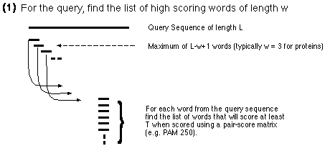
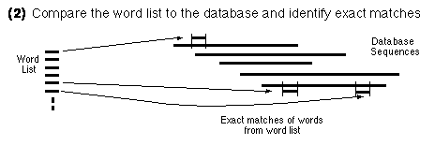
BLAST Algorithm

Slide 33
BLAST Word Matching
MEAAVKEEISVEDEAVDKNI
MEA
EAA
AAV
AVK
VKE
KEE
EEI
EIS
ISV
...
Break query
into words:
Break database
sequences
into words:

Slide 34
Find locations of matching words
in database sequences
ELEPRRPRYRVPDVLVADPPIARLSVSGRDENSVELTMEAT
  MEA
  EAA
  AAV
  AVK
  KLV
  KEE
  EEI
  EIS
  ISV
TDVRWMSETGIIDVFLLLGPSISDVFRQYASLTGTQALPPLFSLGYHQSRWNY
IWLDIEEIHADGKRYFTWDPSRFPQPRTMLERLASKRRVKLVAIVDPH

Slide 35
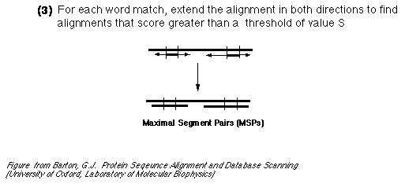
Extend hits one base at a time

Slide 36
Seq_XYZ:
HVTGRSAF_FSYYGYGCYCGLGTGKGLPVDATDRCCWA
Query:
QSVFDYIYYGCYCGWGLG_GK__PRDA
E-val=10⁻¹³
Use two word matches as anchors to build an alignment
between the query and a database sequence.
Then score the alignment.

Slide 37
HSPs are Aligned Regions
The results of the word matching and attempts to extend the alignment are segments
  - called HSPs (High-Scoring Segment Pairs)
BLAST often produces several short HSPs rather than a single aligned region

Slide 38
>gb|BE588357.1|BE588357 194087 BARC 5BOV Bos taurus cDNA 5'.
Length = 369
Score = 272 bits (137), Expect = 4e-71
Identities = 258/297 (86%), Gaps = 1/297 (0%)
Strand = Plus / Plus
Query: 17 aggatccaacgtcgctccagctgctcttgacgactccacagataccccgaagccatggca 76
|||||||||||||||| | ||| | ||| || ||| | |||| ||||| |||||||||
Sbjct: 1 aggatccaacgtcgctgcggctacccttaaccact-cgcagaccccccgcagccatggcc 59
Query: 77 agcaagggcttgcaggacctgaagcaacaggtggaggggaccgcccaggaagccgtgtca 136
|||||||||||||||||||||||| | || ||||||||| | ||||||||||| ||| ||
Sbjct: 60 agcaagggcttgcaggacctgaagaagcaagtggagggggcggcccaggaagcggtgaca 119
Query: 137 gcggccggagcggcagctcagcaagtggtggaccaggccacagaggcggggcagaaagcc 196
|||||||| | || | ||||||||||||||| ||||||||||| || ||||||||||||
Sbjct: 120 tcggccggaacagcggttcagcaagtggtggatcaggccacagaagcagggcagaaagcc 179
Query: 197 atggaccagctggccaagaccacccaggaaaccatcgacaagactgctaaccaggcctct 256
||||||||| | |||||||| |||||||||||||||||| ||||||||||||||||||||
Sbjct: 180 atggaccaggttgccaagactacccaggaaaccatcgaccagactgctaaccaggcctct 239
Query: 257 gacaccttctctgggattgggaaaaaattcggcctcctgaaatgacagcagggagac 313
|| || ||||| || ||||||||||| | |||||||||||||||||| ||||||||
Sbjct: 240 gagactttctcgggttttgggaaaaaacttggcctcctgaaatgacagaagggagac 296
Notes:
29

Slide 39
BLAST variants

Slide 40
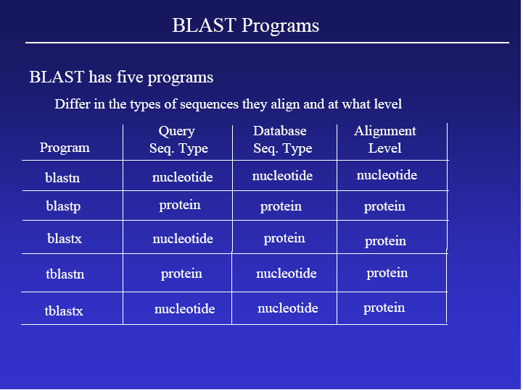

Slide 41
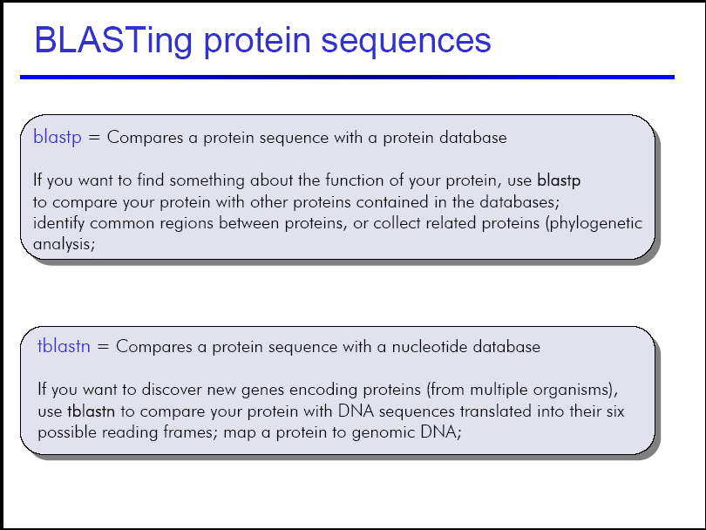

Slide 42
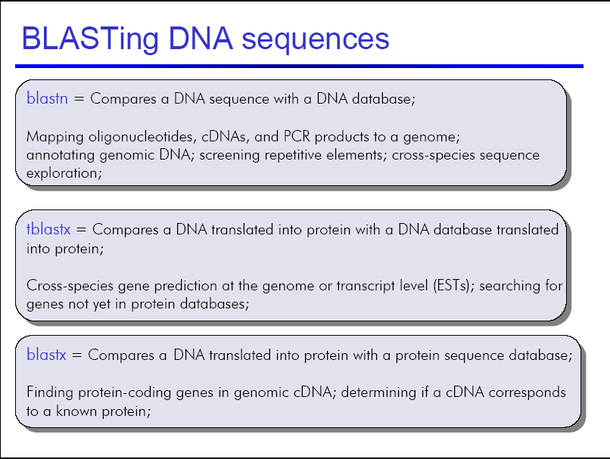

Slide 43
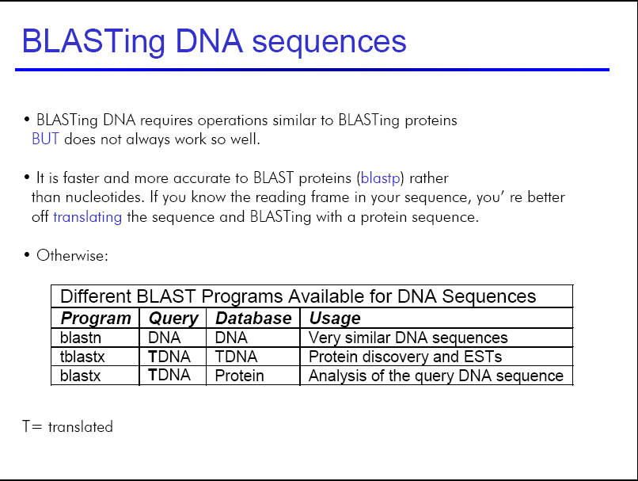

Slide 44
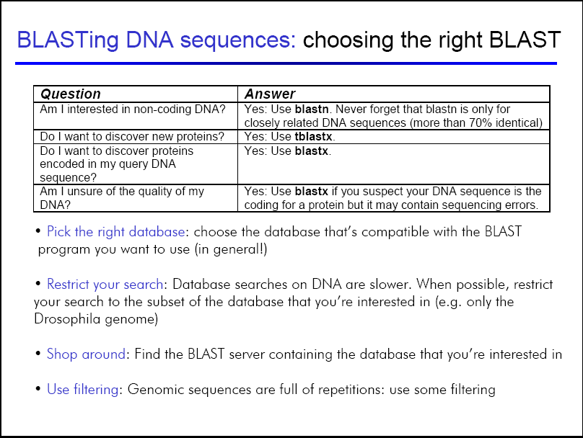

Slide 45
Understanding BLAST output

Slide 46
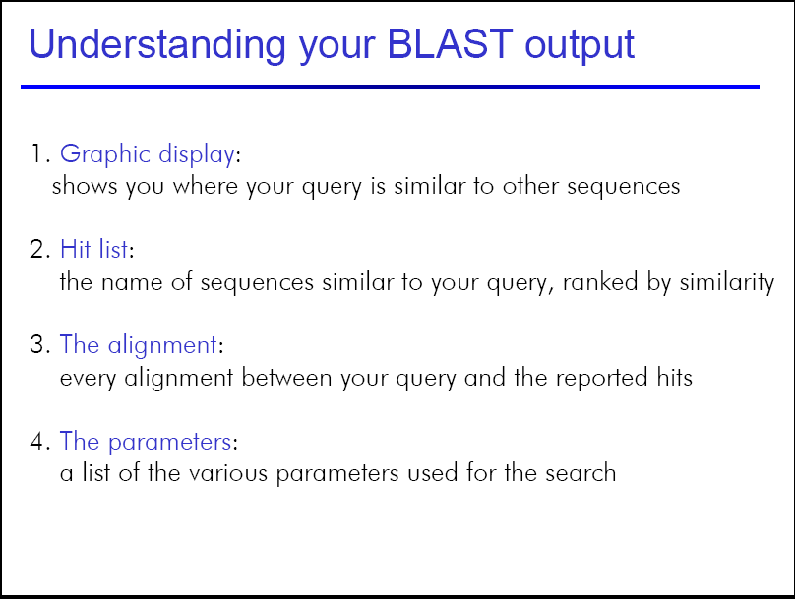

Slide 47
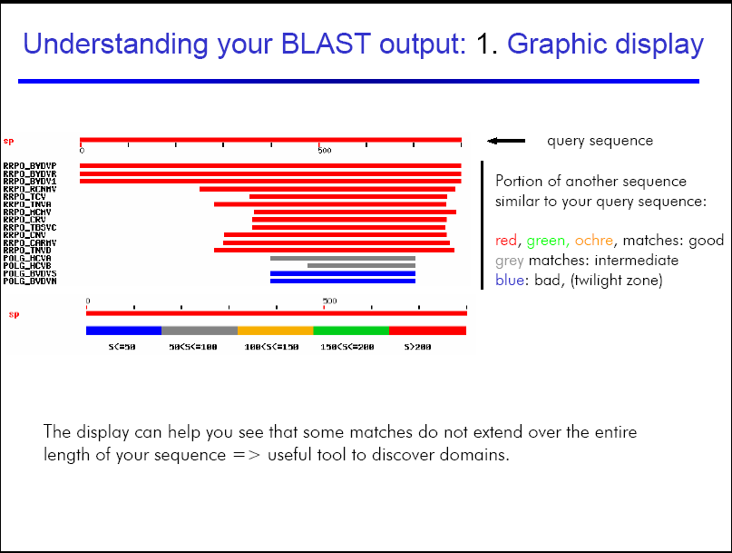

Slide 48
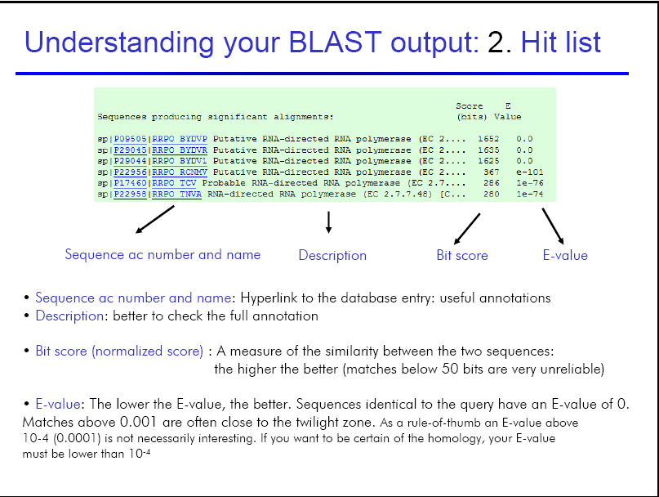

Slide 49
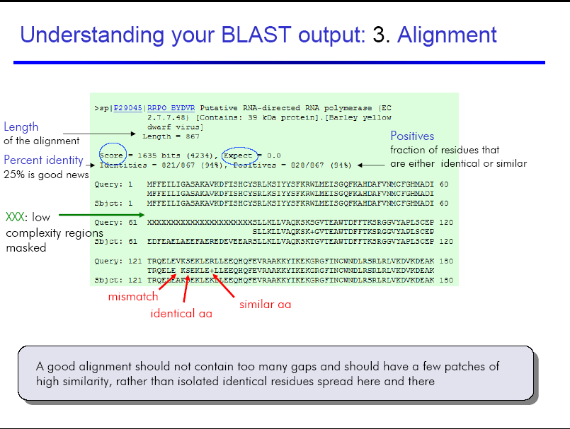

Slide 50
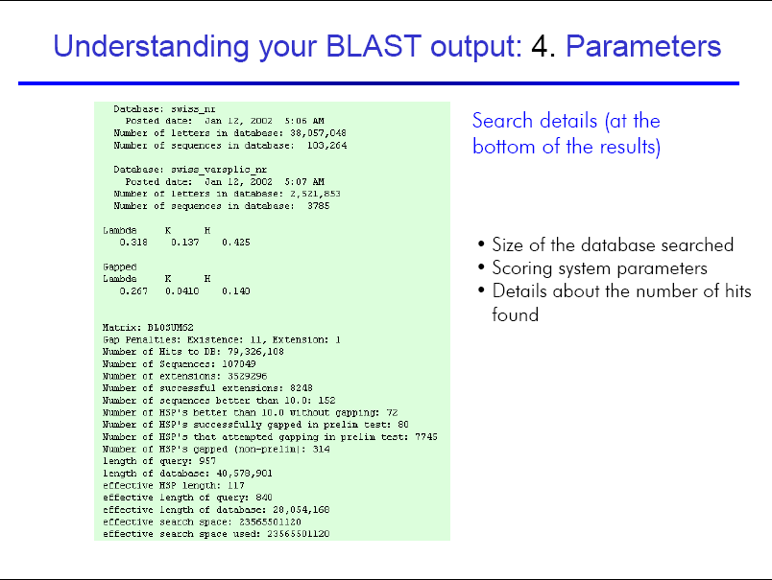

Slide 51
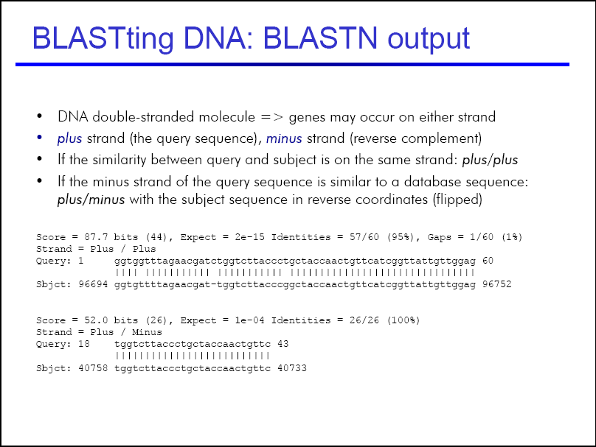

Slide 52
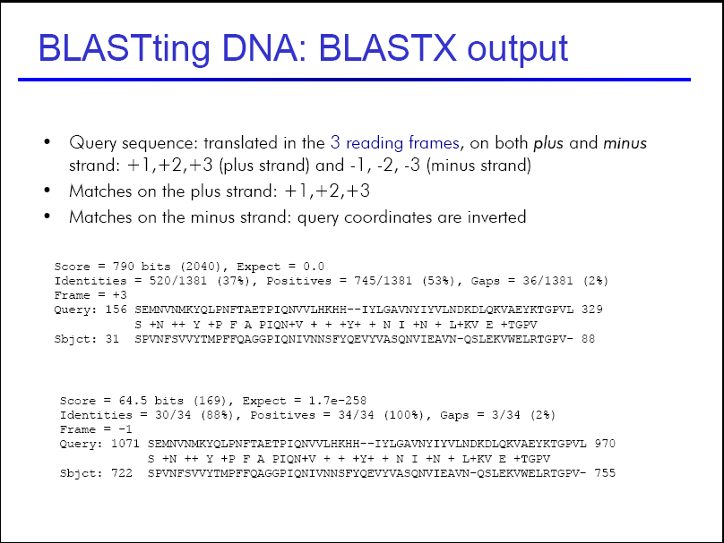

Slide 53
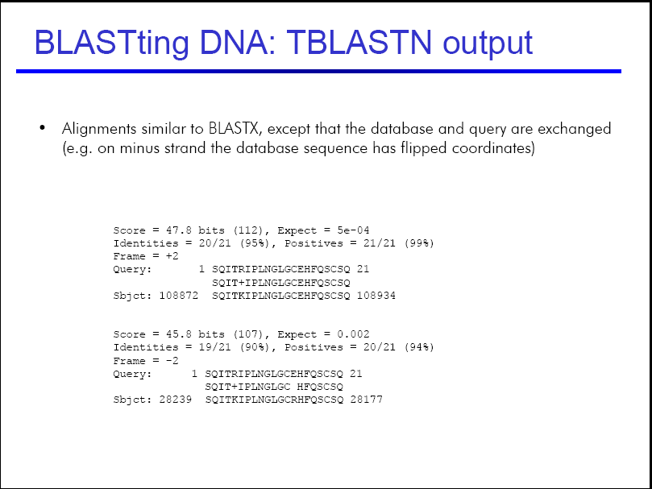

Slide 54
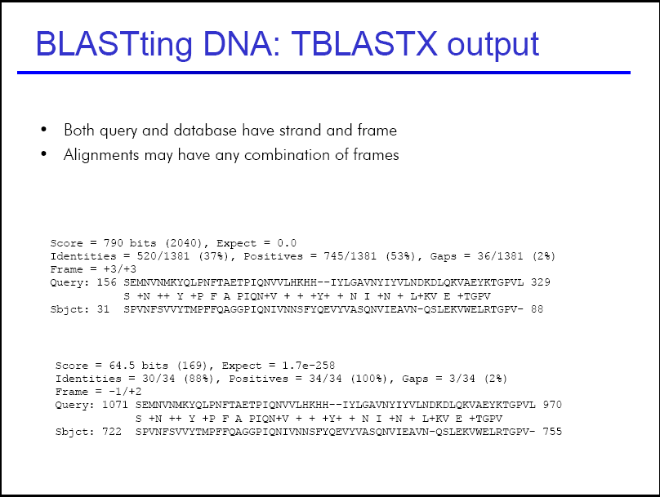

Slide 55
Choosing the right parameters

Slide 56
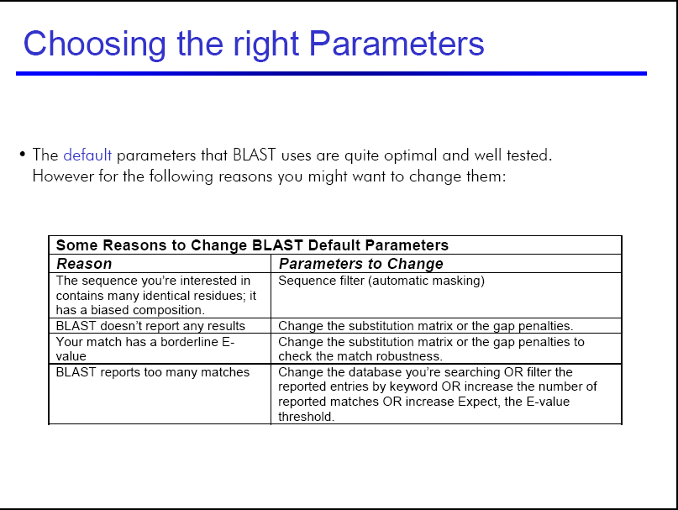

Slide 57
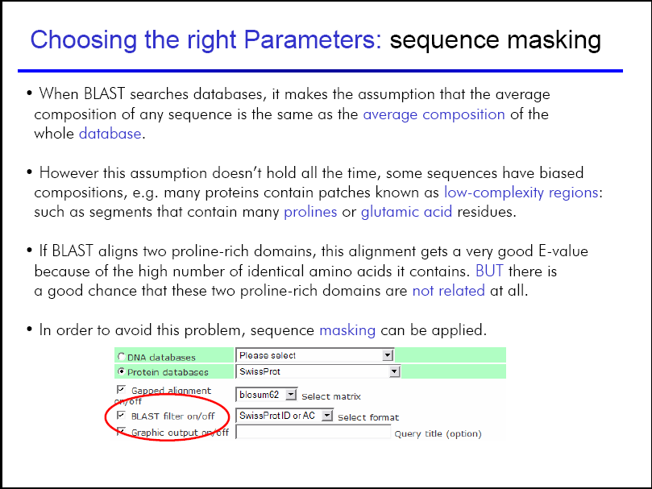

Slide 58
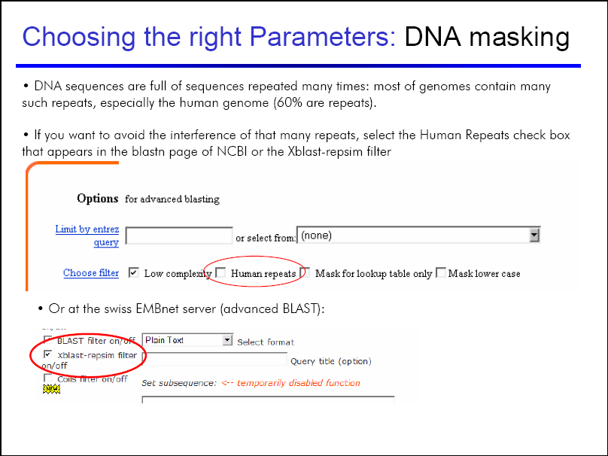

Slide 59
Controlling the output

Slide 60
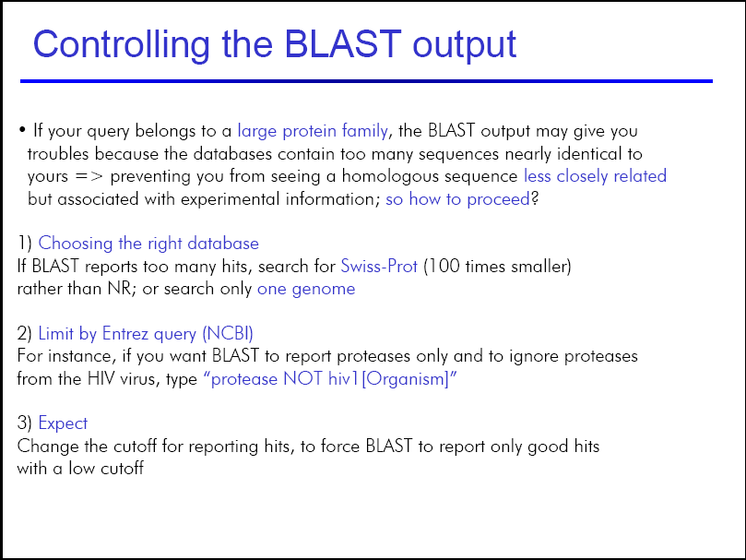

Slide 61
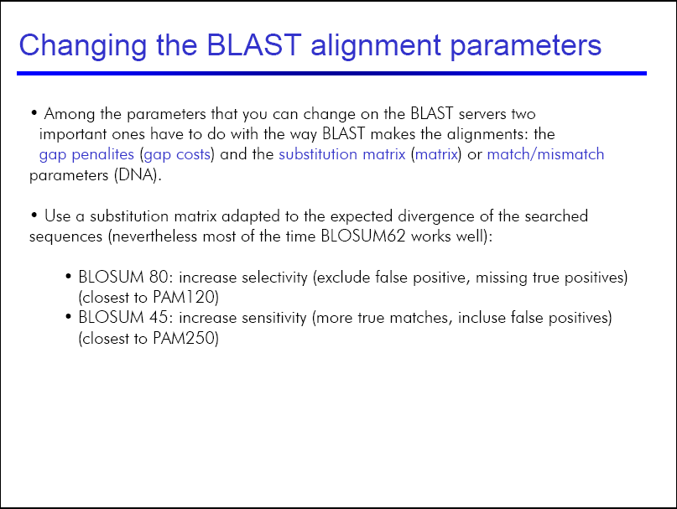

Slide 62
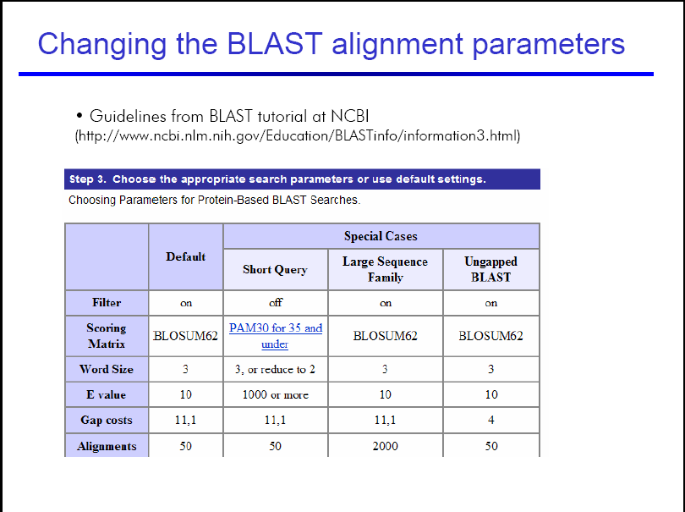

Slide 63
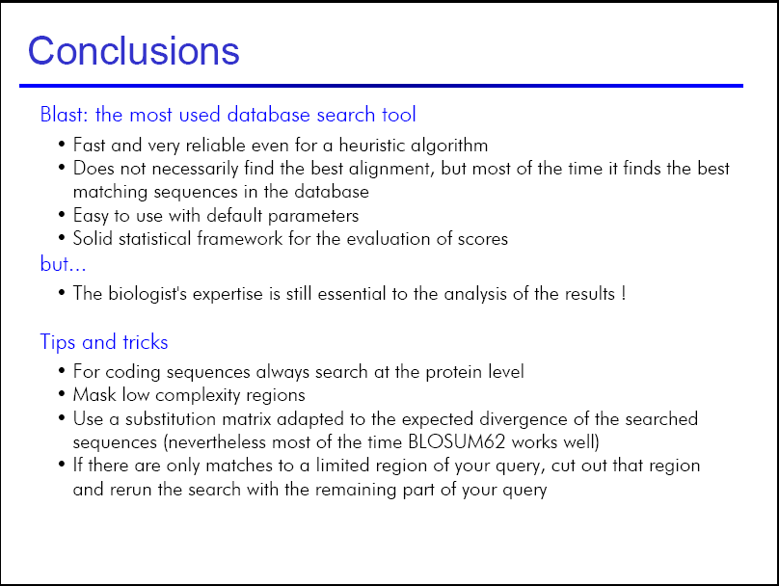

Slide 64
More on BLAST
NCBI Blast Information and Glossary
http://blast.ncbi.nlm.nih.gov/Blast.cgi?CMD=Web&PAGE_TYPE=BlastDocs
Steve Altschul's Blast Course
http://www.ncbi.nlm.nih.gov/BLAST/tutorial/Altschul-1.html

Slide 65
BLASTing the literature

Slide 66
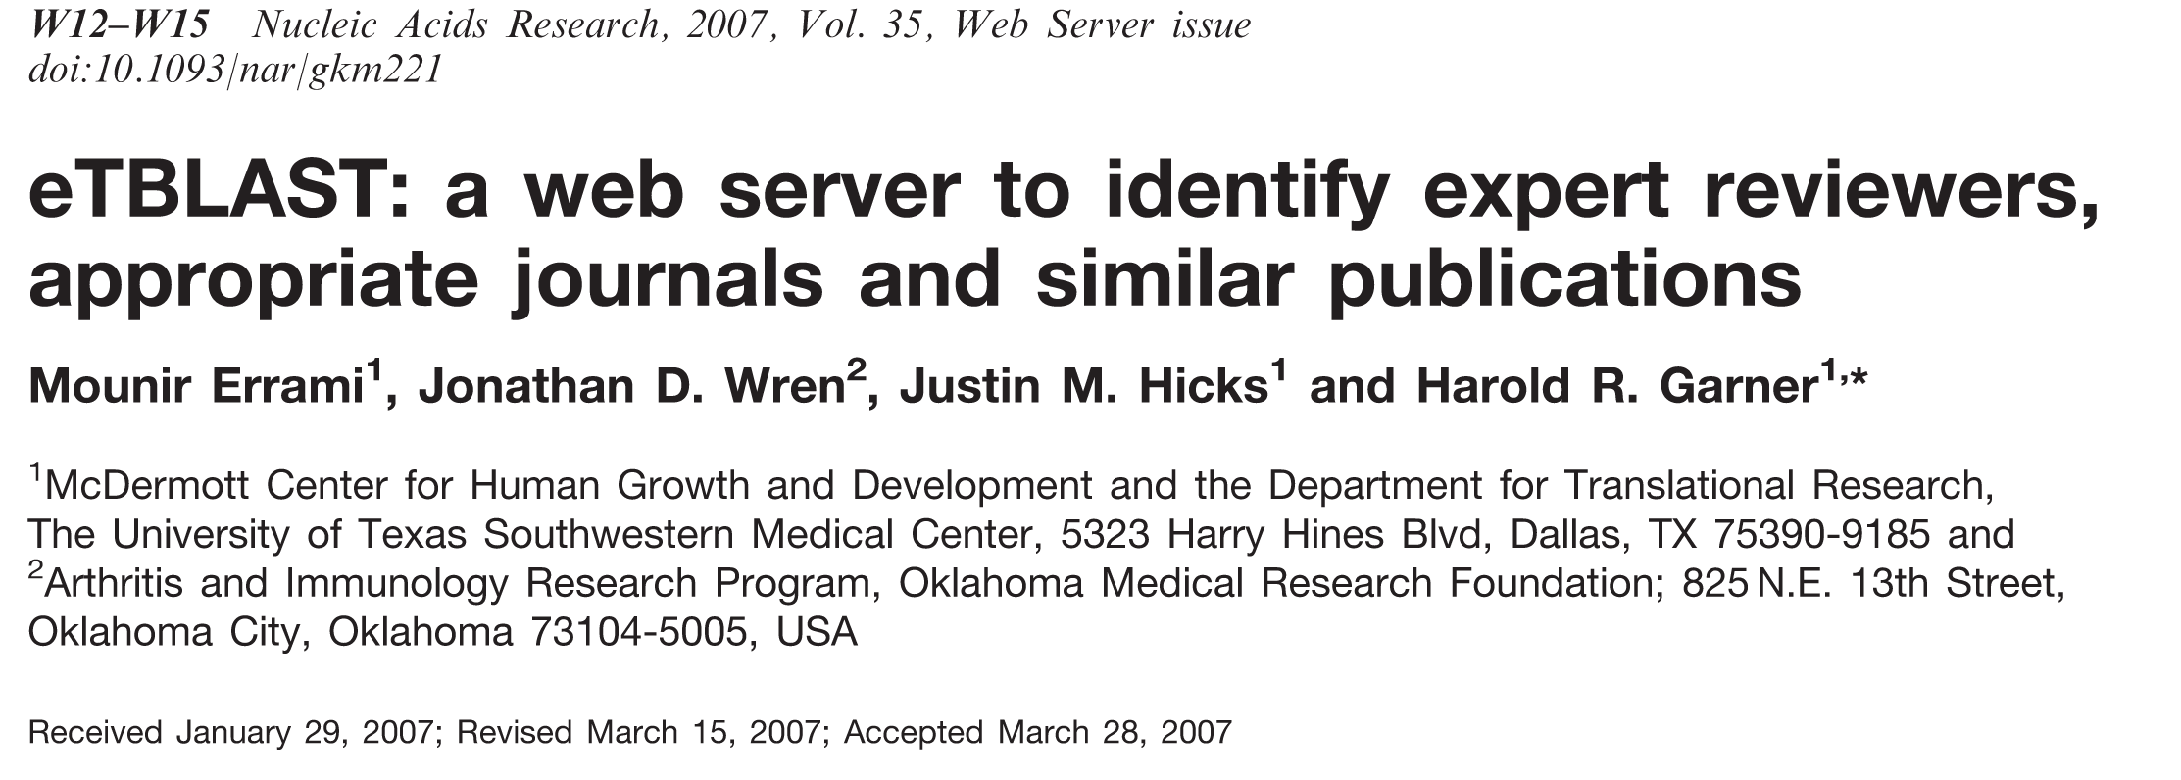

Slide 67
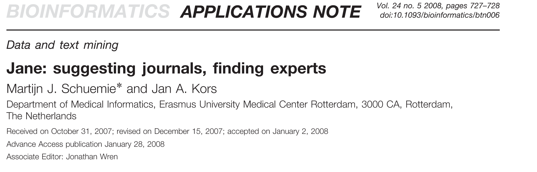

Slide 68
Shusaku Arakawa. 1961. Study for Moral Volumes from the Mechanism of Meaning, pencil on paper.
Sold at a Sotheby's auction in New York in 2001 for $207,500.

Slide 69
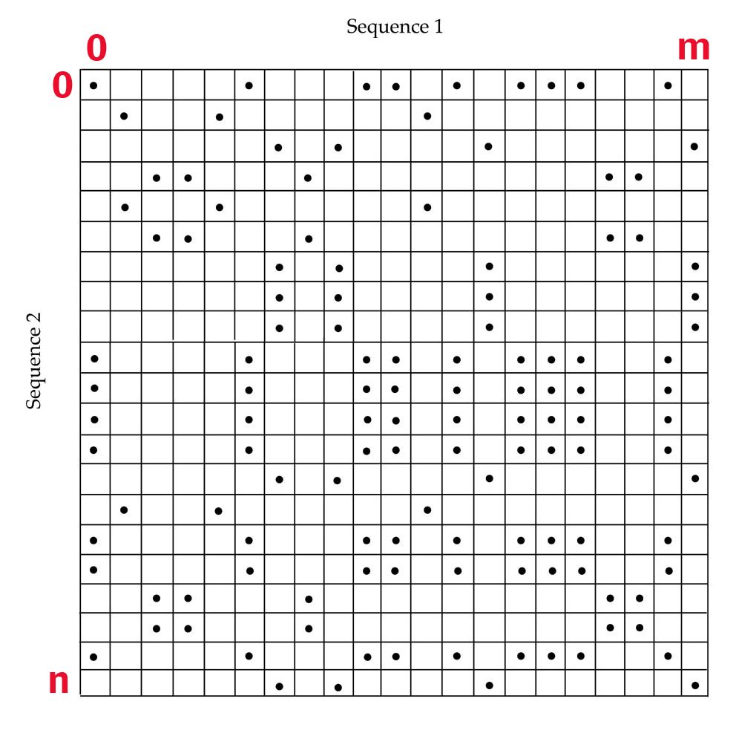
Local vs. Global Alignment
The Global Alignment Problem tries to find the longest path between vertices (0,0) and (n,m) in the edit graph.
The Local Alignment Problem tries to find the longest path among paths between arbitrary vertices (i,j) and (i’,j’) in the edit graph.

Slide 70
Local vs. Global Alignment
Global Alignment
Local Alignment—better alignment to find conserved segment
--T—-CC-C-AGT—-TATGT-CAGGGGACACG—A-GCATGCAGA-GAC
| || | || | | | ||| || | | | | |||| |
AATTGCCGCC-GTCGT-T-TTCAG----CA-GTTATG—T-CAGAT--C
tccCAGTTATGTCAGgggacacgagcatgcagagac
||||||||||||
aattgccgccgtcgttttcagCAGTTATGTCAGatc

Slide 71
Local Alignments: Why?
Two genes in different species may be similar over short conserved regions and dissimilar over remaining regions.
Example:
  Homeobox genes have a short region called the homeodomain that is highly conserved between species.
  A global alignment would not find the homeodomain because it would try to align the ENTIRE sequence

Slide 72
Link for Dynamic Programming tutorial:
http://www.sbc.su.se/~pjk/molbioinfo2001/dynprog/dynamic.html

